Slide 1
Detection of Electricity Charging Fraud

Slide 2
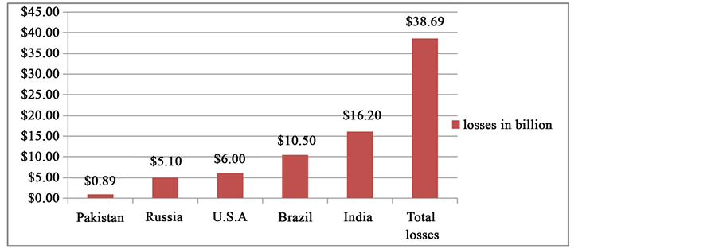
Problem Statement:
Electricity companies are incurring losses from fraudulent electricity subscribers
Risk of electricity fraud on national income

Slide 3
Project Idea:
Provide electricity companies with indicators and insights to detect Electricity fraudulent Subscribers (Electricity consumption analysis system)
About the Product:
It’s a dashboard that can be accessed by electricity companies employees
In the future, it will be linked to the companies charging system through API
It provide results and clusters about most likely fraud users to be checked and labeled

Slide 4
Available Solutions in the Market:
Most of them are technical or traditional ones, such as :
Random and planned field visits by the employees
Upgrading the electricity meters
No solid solution was based on historical data (Data Product)
Our Solution:
Data based product, provide insights to help in the detection of fraud electricity users.
Covering all the ways and methods used to steel electricity
Complementary for technical and traditional solutions

Slide 5
Main Features:
General Indicators and measures, such as:
Basic Statistics of consumptions, like average consumption per customer, top 1000 customer, average period between charges
Categorization of customers based on consumption trends
List of expected fraudulent users, with the probability of being fraudulent user.
When fraud cases are determined, machine learning algorithms will be used to make the results more accurate

Slide 6
Product Prototype

Slide 7
THANK YOU

